Slide 1

ML based prediction of stress in cavity expansion problem Special Problem under Dr. Chloe Arson
Sanshrit Singhai
03/28/2022

Slide 2
Introduction
Model Description
Discussion & Conclusion
Project Objective
Evaluating the stress, elastic and plastic strain fields around the cavity at the new location
Based on Inputs: position, geometry of robot (modeled as cavity), soil parameters or sensor data (e.g., pressure-volume curve)
Bypass the simulation and generate the output (Stresses) from the trained ML model.

Slide 3
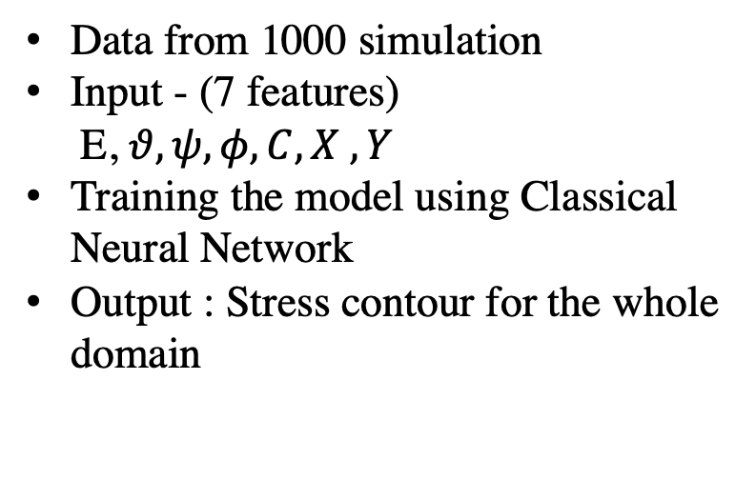
Introduction
Model Description
Discussion & Conclusion
ML based Prediction
Classical Neural Network
Convolutional Neural Network
Data from 1000 simulation
Input - (7 features)
E, $θ, ψ, φ, C, X , Y$
Training the model using Classical Neural Network
Output : Stress contour for the whole domain
Data from 1000 simulation
Input – Stress at the lining of cavity
Using Deep Insight Algorithm to generate input images from the data.
Training the model using Convolutional Neural network
Output : Stress at a distance of 1.5 m from the center of cavity

Slide 4
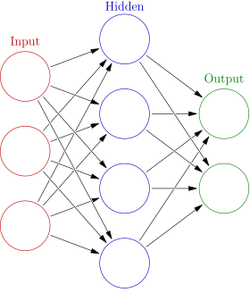

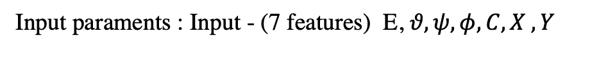
Introduction
Model Description
Discussion & Conclusion
Approach 1: Using Classical Neural Network to evaluate the stress field in the whole domain
Importing Simulation Data (1000 Simulations)
Each simulation has ~ 8000 nodes
Input paraments : Input - (7 features) E, $θ, ψ, φ, C, X , Y$
Data Cleaning for the Model
3 Hidden Layers: 13,8,8 units with Leaky ReLU as Activation
Output Layer : 5 units with linear activation
Splitting the data between training (0.9) and training (0.1)
Total data set: Approx. 0.8 Million
Output as the stress at the nodes based on the mechanical properties and location
Optimizer : ADAM
Metric: MSE = $3.5×{10}^{−4.}$

Slide 5
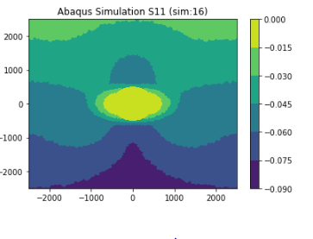
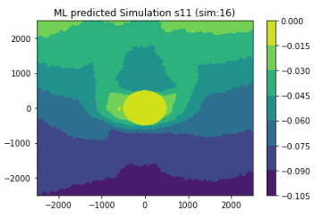
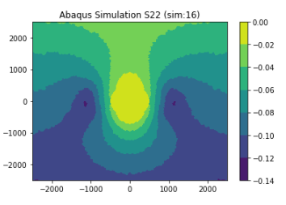
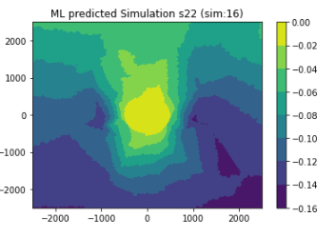
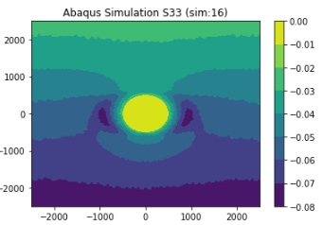
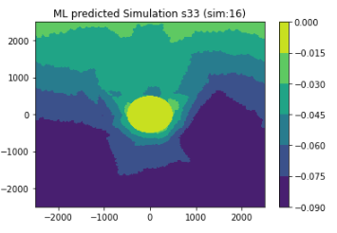
Introduction
Model Description
Discussion & Conclusion
Results : Using Classical Neural Network to evaluate the stress field in the whole domain (Simulation -16)
Figure 1: Stress field by ML predicted model for Simulation-16

Slide 6
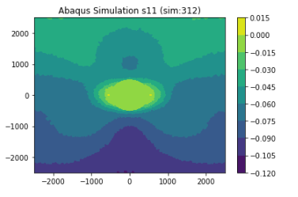
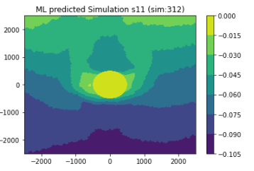
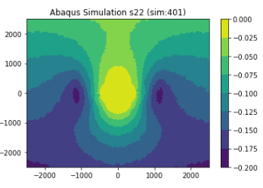
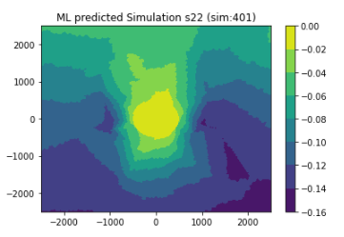
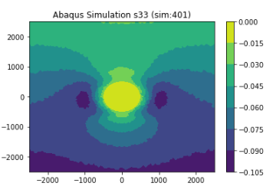
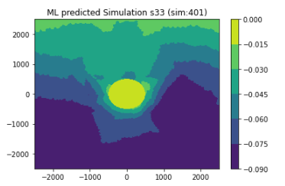
Introduction
Model Description
Discussion & Conclusion
Results : Using Classical Neural Network to evaluate the stress field in the whole domain (Simulation 401)
Figure 1: Stress field by ML predicted model for Simulation-16

Slide 7
Introduction
Model Description
Implementation for TXC
Discussion & Conclusion
Approach 2: Using Classical Neural Network to evaluate the stress field at distance of x from the center of cavity
Importing Simulation Data (1000 Simulations)
Convert the x,y coordinate to polar coordinate
Consider the discretized inner nodes (128)
So, 128 features for the model for 1000 simulations
Inner Lining with r1 = 500mm
r2
r1
ANN
Output: Stress at (36 nodes) the distance of 1500 mm from the center of cavity
Outer Lining with r2 = 1500mm
Problem: Very High MSE , Multiple hidden layers

Slide 8
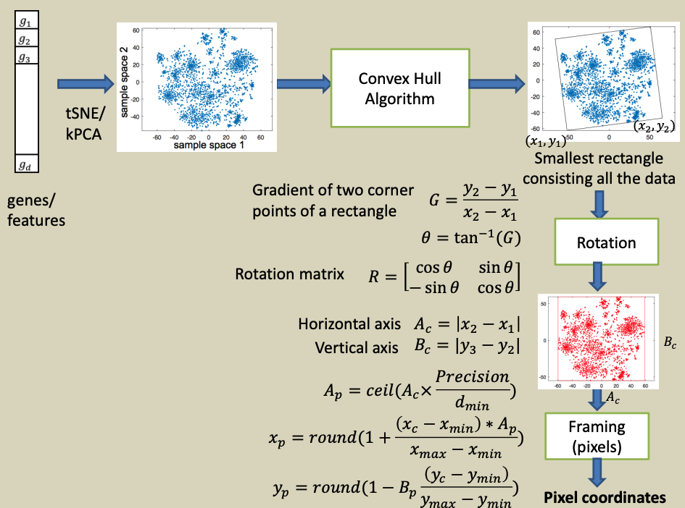
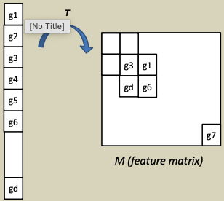
Introduction
Model Description
Discussion & Conclusion
Approach 3 : Using CNN for predicting the Stress Field
Converting Tabular data into an Image
Each sample corresponding to n features will be transformed into a matrix
This approach will help in capturing the spatial relation between the features
Similar features will be close to each other in a matrix.
Features: g1,gd,g3,g6 are similar
- Sharma, A., Vans, E., Shigemizu, D. et al. DeepInsight:

Slide 9
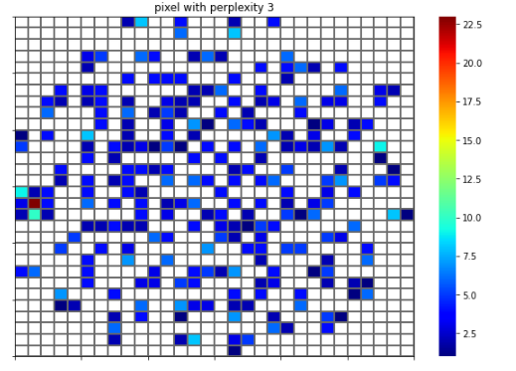
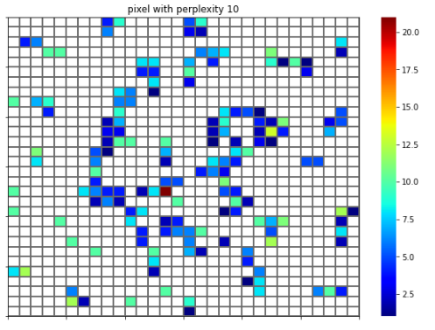
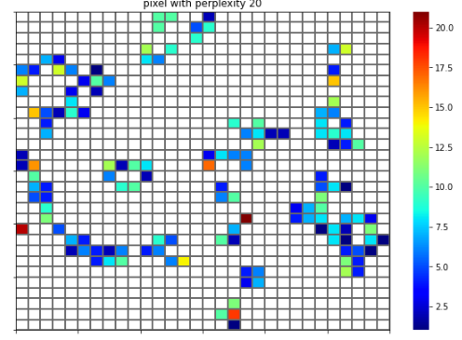
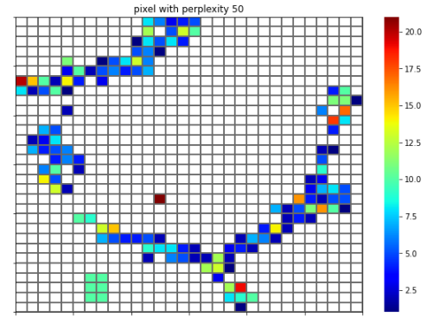
Introduction
Model Description
Discussion & Conclusion
Results : Generated Images based on DeepInsight Algorithm for CNN model
Figure 3: Images from data using DeepInsight Algorithm with varying perplexity

Slide 10
Model Description
Discussion & Conclusion
Introduction
Approach 1: Using ANN for predicting of stress field works based on mechanical properties (7 features) works well in predicting the response.
Approach 2: Using ANN for predicting the stress contour at distance x based on the known stress at the lining of the cavity.
Problems : High MSE , Optimum number of hidden layers to improve the model performance
Approach 3: Using CNN instead of ANN to compare the spatial relation between the features.
Problems :
- Generating images from DeepInsight Algorithm, It was expected to generate an image separately for each training examples. The number of features are less in the present problem.
Using CNN for prediction and generating an output Image from Input Image (Segenet)
Is ANN sufficient enough for the present problem.

Slide 11
References
Sharma, A., Vans, E., Shigemizu, D. et al. DeepInsight: A methodology to transform a non-image data to an image for convolution neural network architecture. Sci Rep 9, 11399 (2019). https://doi.org/10.1038/s41598-019-47765-6

